Slide 1
TensorFlow to Classify Chest X-Rays
Daniel Chang

Slide 2
Goal
Use Convolutional Neural Networks to diagnose Covid-19 or pneumonia using Chest X-Rays

Slide 3
Dataset
Obtained from Mendeley Data
603 Chest X-rays in 3 classes
221 – Covid-19
234 – Normal
148 – Pneumonia
Resized to 512x512
Notes:
Mendeley Data - Chest X-ray images with three classes: COVID-19, Normal, and Pneumonia

Slide 4
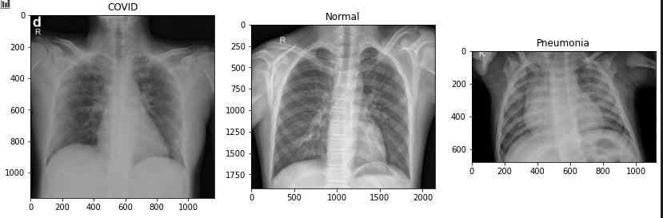
Dataset:

Slide 5
Hyperparameter Tuning
3 Convolution layers with output filter layers
16, 32, 64
32, 64, 128
Optimizer
SGD
Adam
10 Epochs each

Slide 6
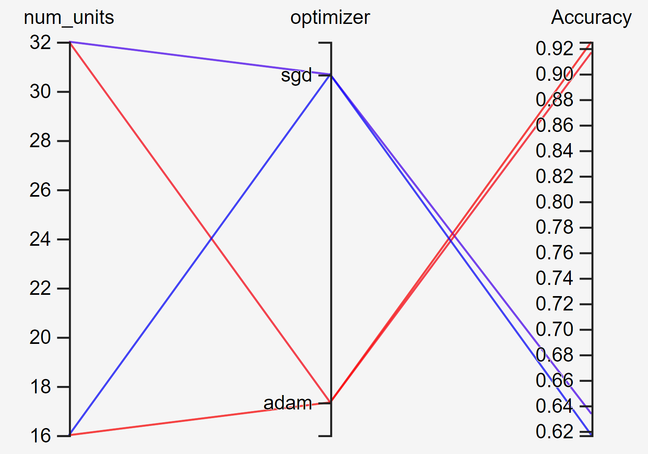
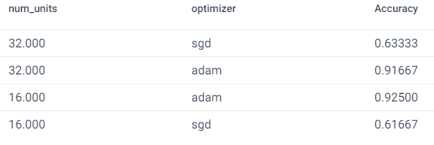
Hyperparameter tuning

Slide 7
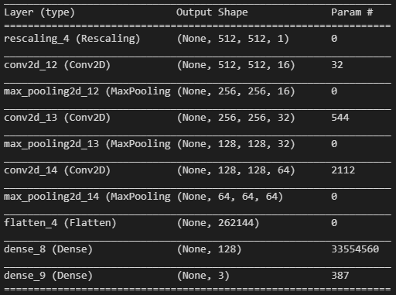
Model Summary

Slide 8
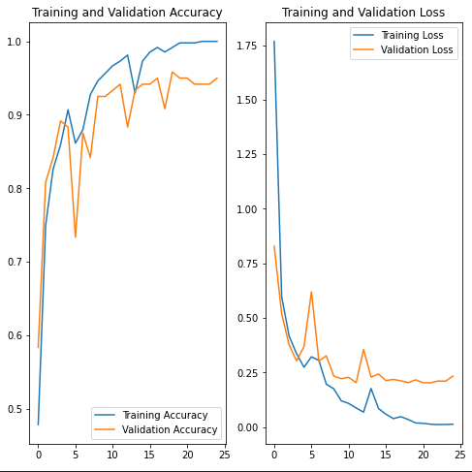
More Training
Final Epoch:
Accuracy Loss
Training: 1.0 0.147
Validation: 0.95 .2338

Slide 9
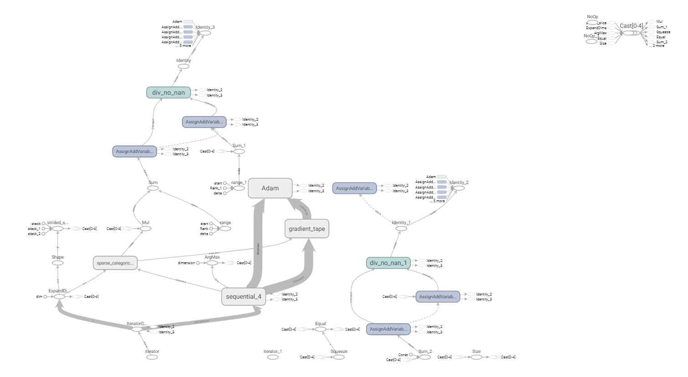
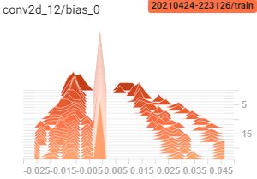
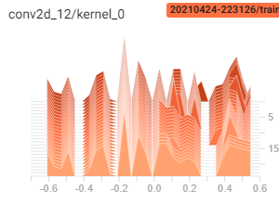
TensorBoard

Slide 10
Conclusion
Appears we can accurately diagnose Chest X-Rays
Could use more data

